Slide 1
By Aarti Dhage
Uber Ride Analysis Dashboard

Slide 2
UBER RIDE ANALYSIS
This dashboard helps us understand Uber ride performance.
It shows bookings, completed rides, cancellations, vehicle demand, payments and customer ratings.
The goal is to find problems and suggest improvements.
1

Slide 3
1. Business Objective
What do we want to understand?
How many bookings did Uber receive?
How many rides were completed?
Why are some rides cancelled?
Which vehicle is most popular?
Which payment method is used more?
Are customers happy with the service?
2

Slide 4
2. Data Used
Information used to create the dashboard
Booking ID and Booking Date
Booking Status
Vehicle Type
Payment Method
Fare / Revenue
Ride Distance
Customer Rating
Before analysis, the data should be checked for missing and duplicate values.
3

Slide 5
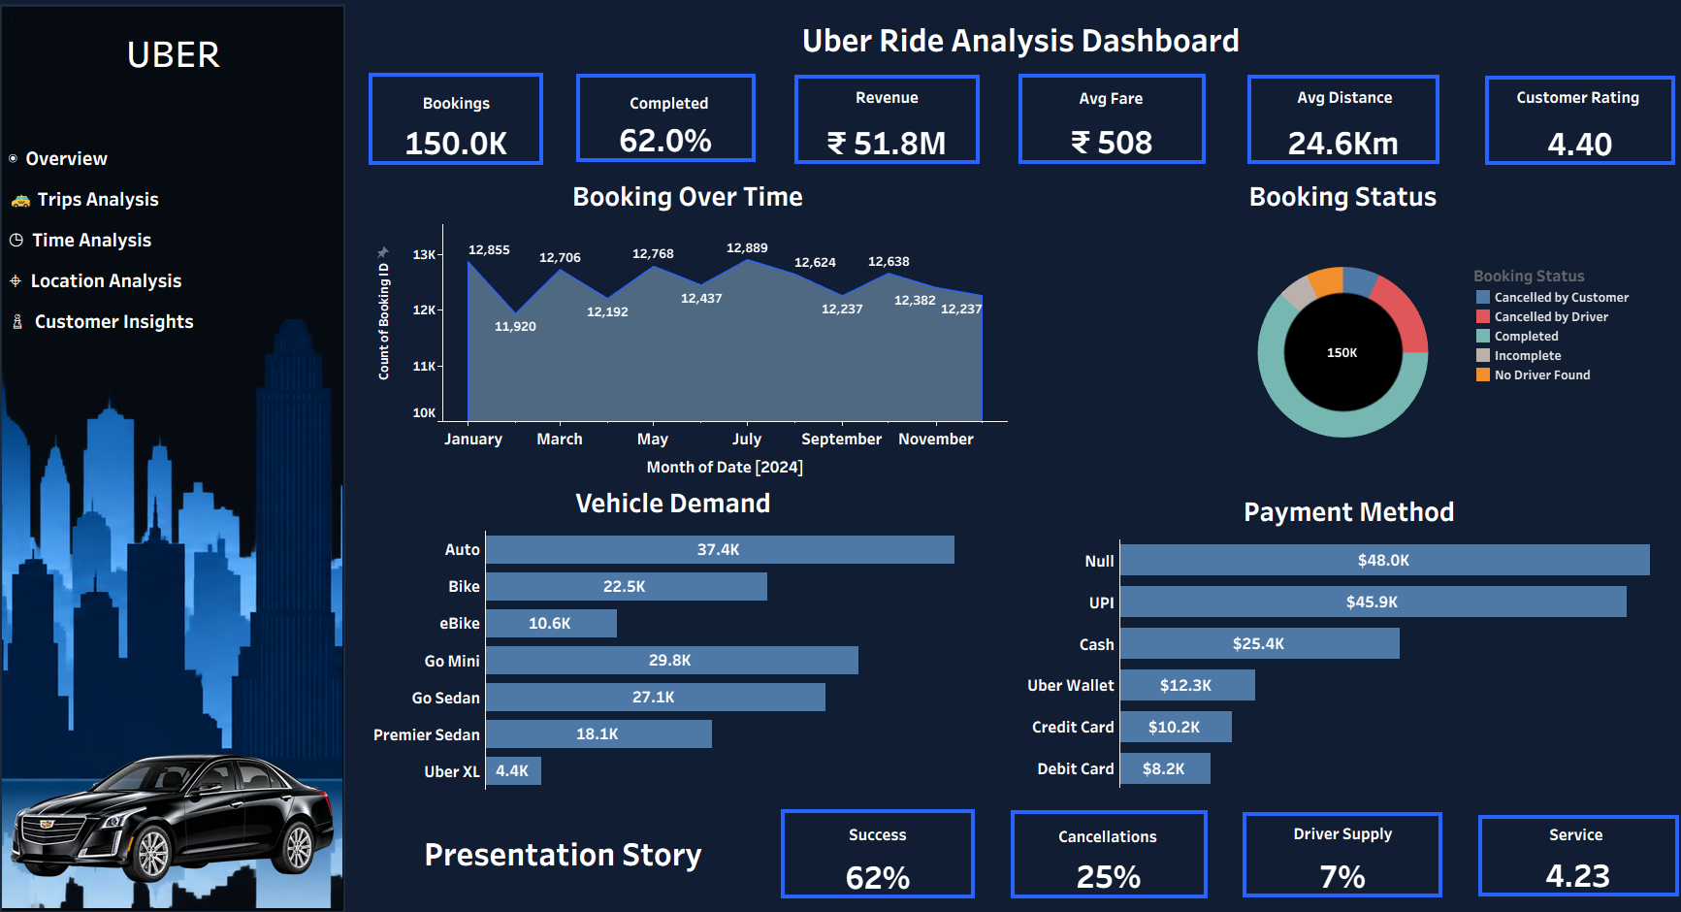

Slide 6
3. Main KPIs
Important numbers from the dashboard
These numbers give us a quick idea of the overall business performance.
The most important KPI is completion rate because it tells us how many bookings become successful rides.
4

Slide 7
4. Booking Trend
Bookings during 2024
Bookings are fairly stable during the year.
July has the highest bookings: about 12.9K.
February has the lowest bookings: about 11.9K.
This means Uber has regular demand throughout the year.
We can further check peak hours and busy days to understand demand better.
5

Slide 8
5. Booking Status
What happened to the bookings?
62% of bookings were completed.
Some bookings were cancelled by customers.
Some were cancelled by drivers.
Some bookings were incomplete or had no driver available.
The main goal should be to reduce cancellations and increase completed rides.
6

Slide 9
6. Vehicle Demand
Which vehicles are used more?
Auto has the highest demand: 37.4K.
Go Mini: 29.8K.
Go Sedan: 27.1K.
Bike: 22.5K.
Premier Sedan: 18.1K.
eBike: 10.6K and Uber XL: 4.4K.
Uber can keep more drivers available for vehicles with higher demand.
7

Slide 10
7. Payment Method
How are customers paying?
UPI is one of the major payment methods in the dashboard.
Cash, Uber Wallet and Cards are also used.
There is a large 'Null' payment category.
Null means payment information is missing or not properly recorded.
This data should be cleaned before making a final payment-related decision.
8

Slide 11
8. Customer Satisfaction
Are customers happy?
The average customer rating is 4.40.
This shows that customers are generally satisfied.
But we can check ratings by vehicle, location and time.
This can help us find where customers are having problems.
9

Slide 12
9. Key Findings
What did we learn?
Uber has a high number of bookings.
Only 62% of bookings are completed.
Cancellations are an important area to improve.
Auto has the highest demand.
Customer rating is good at 4.40.
Payment data has missing values.
Demand is fairly stable during the year.
10

Slide 13
10. Recommendations
What can Uber improve?
Reduce customer and driver cancellations.
Increase drivers in high-demand areas and times.
Focus on high-demand vehicles such as Auto and Go Mini.
Fix missing payment information.
Study low customer ratings and improve service.
Try to increase the 62% completion rate.
11

Slide 14
11. Future Scope
What else can we analyze?
Peak-hour analysis
Weekday vs weekend bookings
Location-wise demand
Repeat customers
Driver performance
Cancellation reasons
Revenue by vehicle type
Future demand prediction
12

Slide 15
12. Conclusion
This dashboard makes Uber data easy to understand.
It helps us see business performance and customer behavior.
The biggest opportunities are reducing cancellations, increasing completed rides and improving driver availability.
Good data quality is also important for making correct decisions.
Thank You!
13

